Slide 2
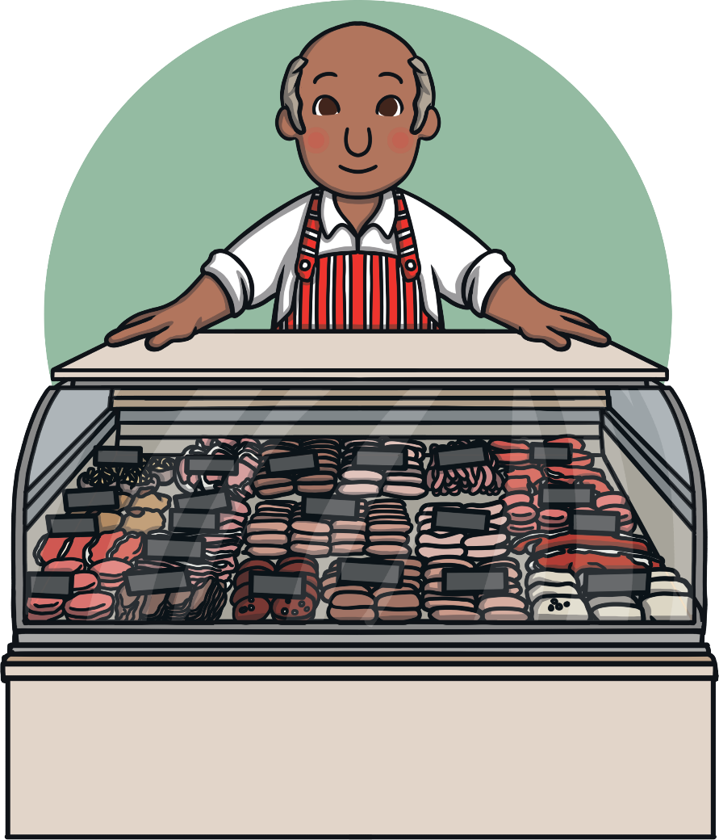
We buy meat at the butcher’s.

Slide 3
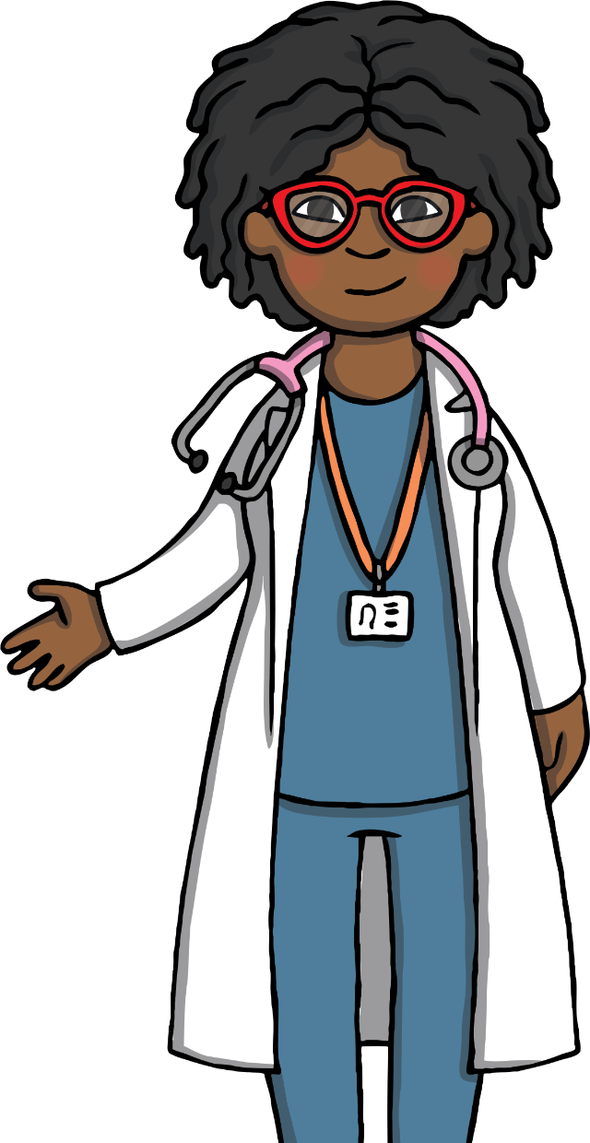
We buy our medicine at the chemist’s.

Slide 4
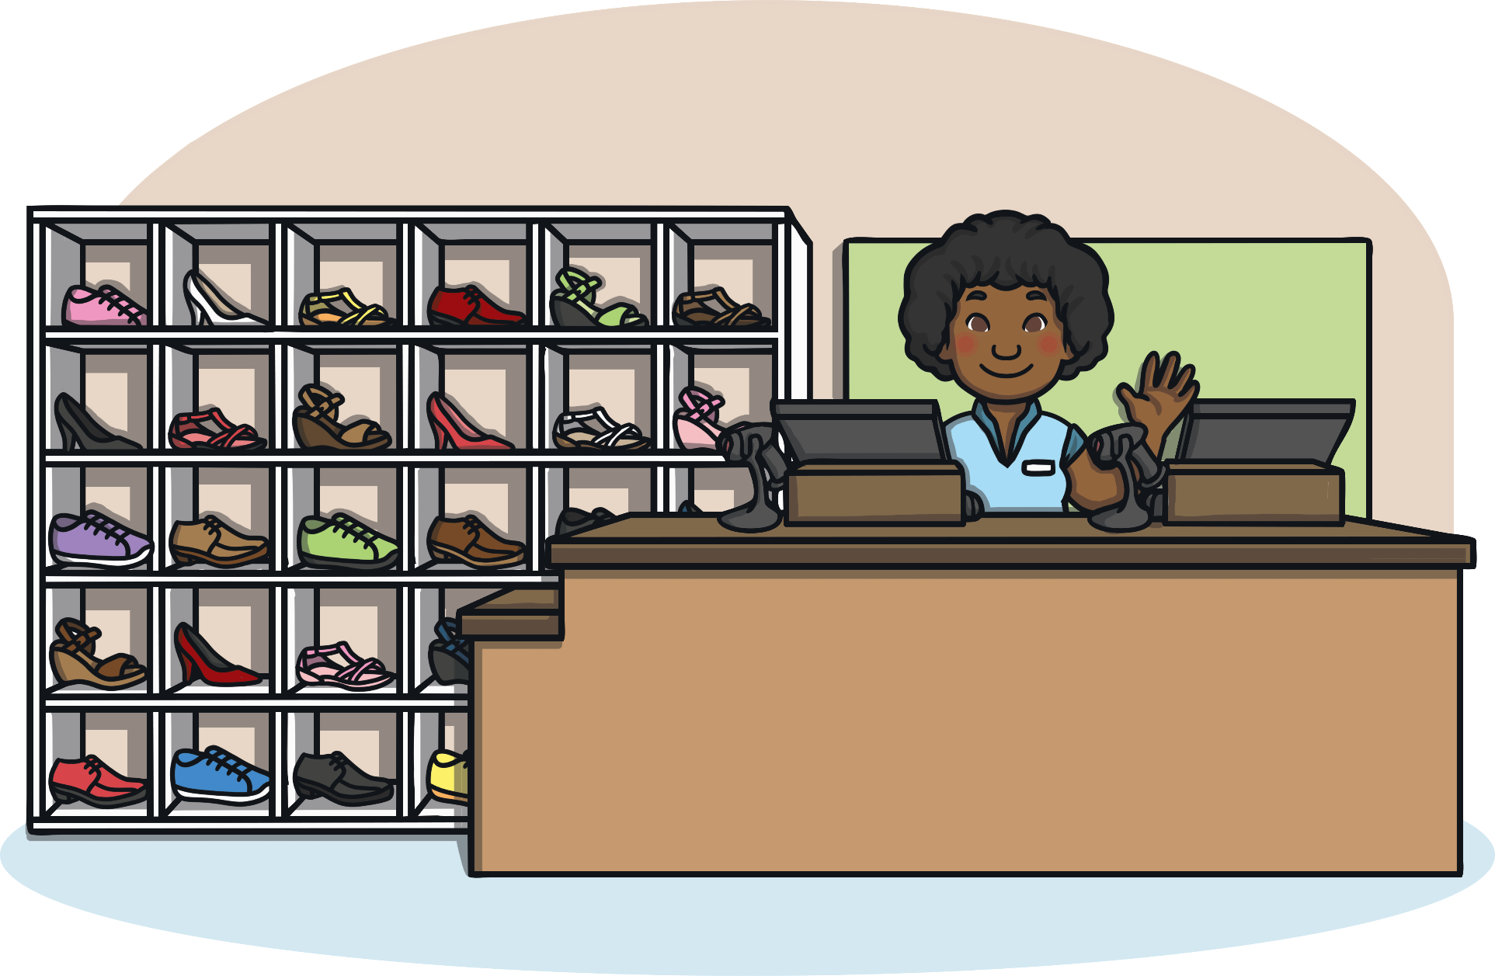
We buy new shoes at a shoe shop.

Slide 5
We can go to primary school when we are four years old.

Slide 6
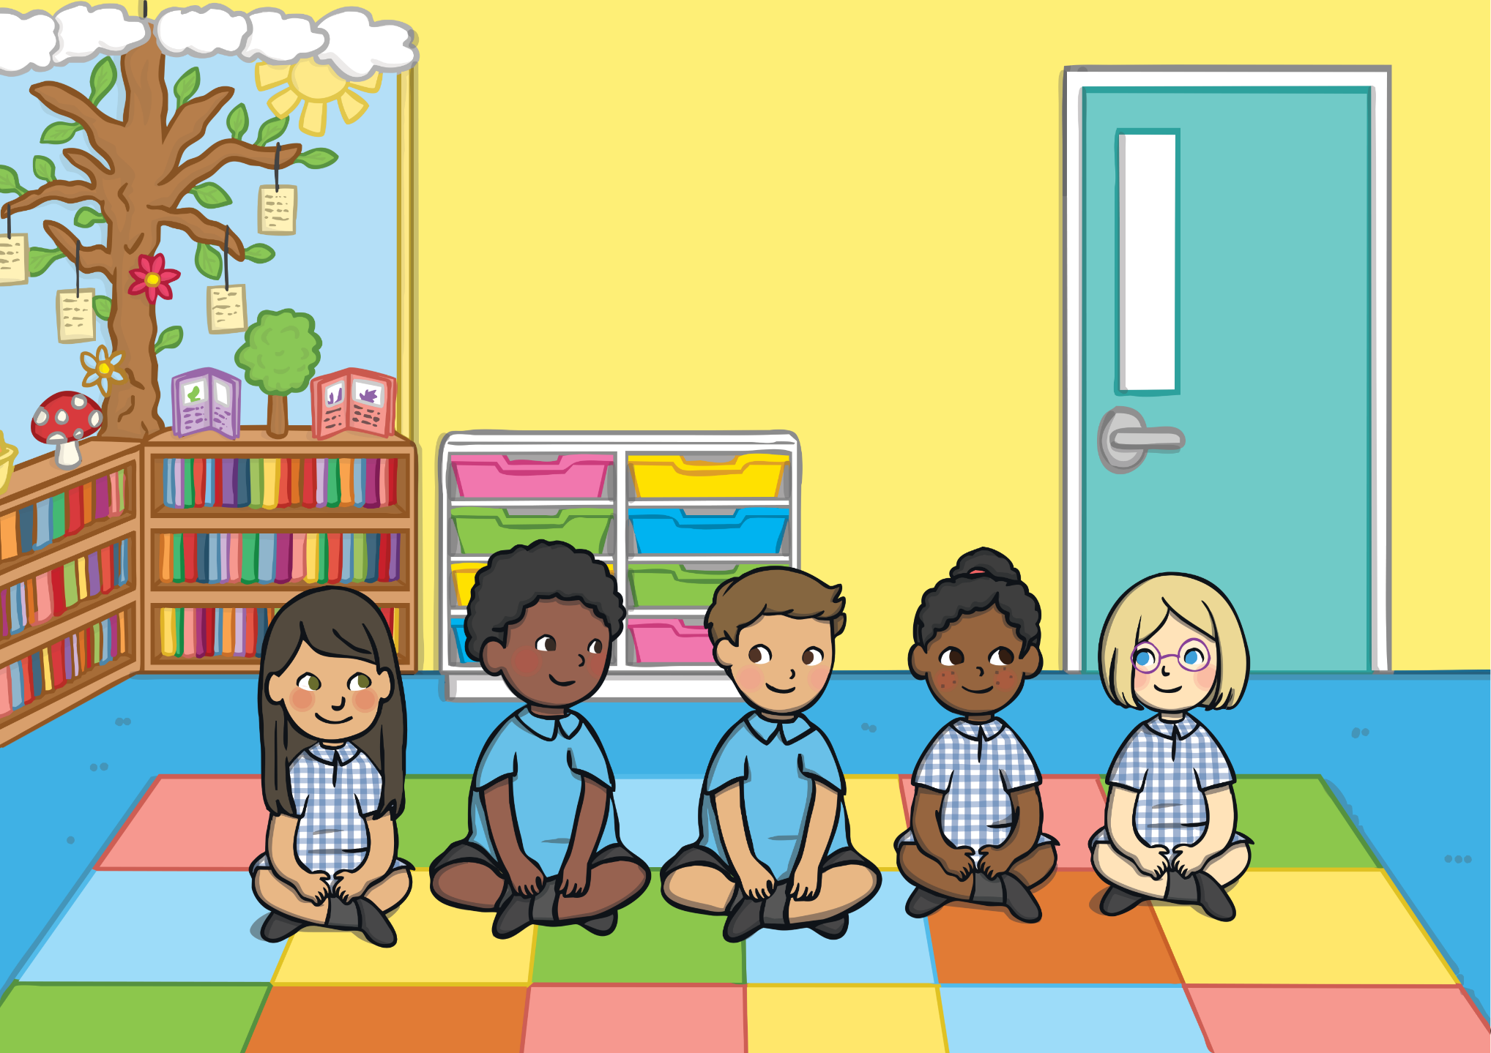
When we are too young to go to primary school, we can go to nursery.

Slide 7
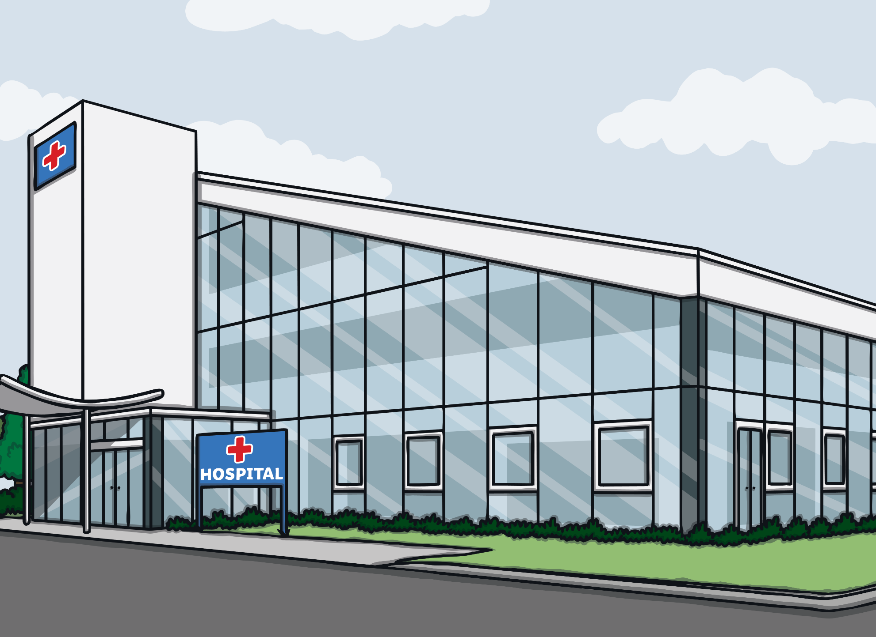
We go for operations at the hospital.

Slide 8
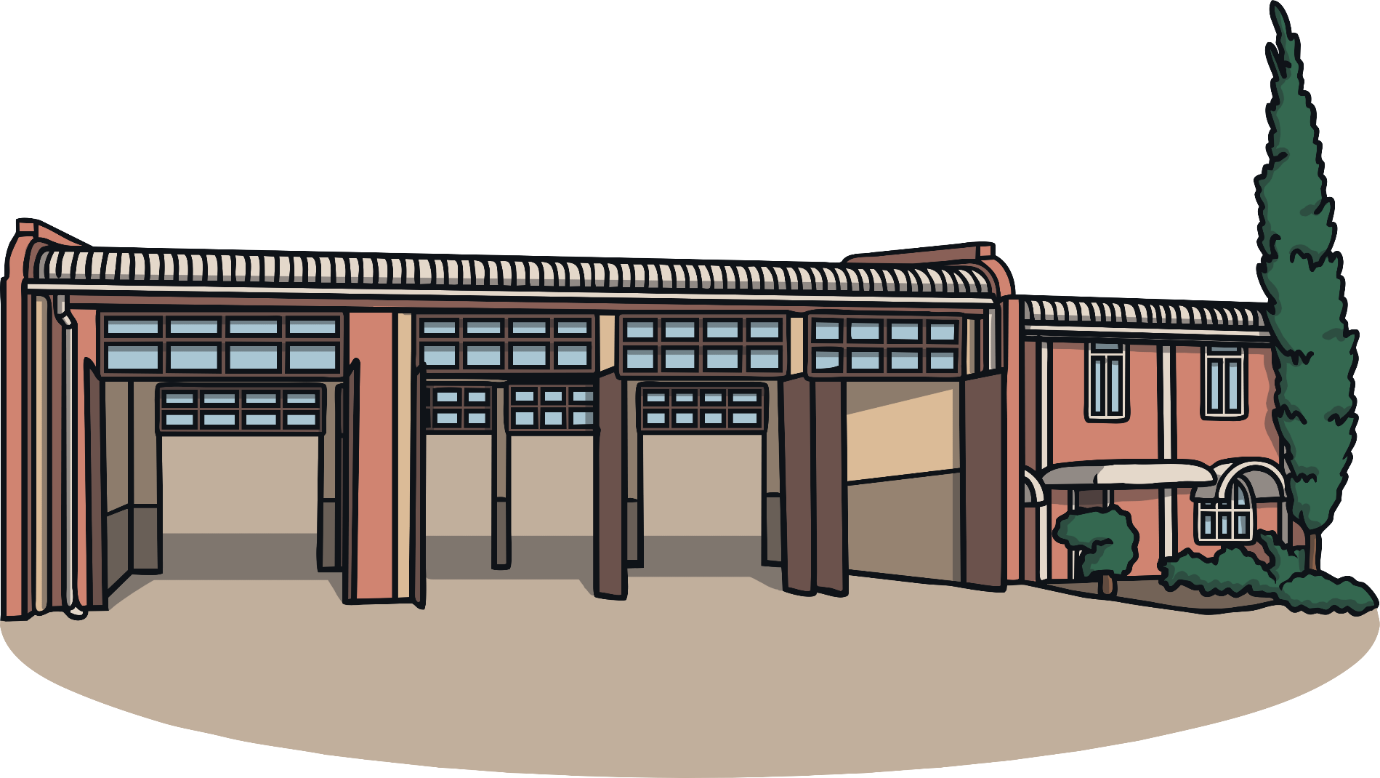
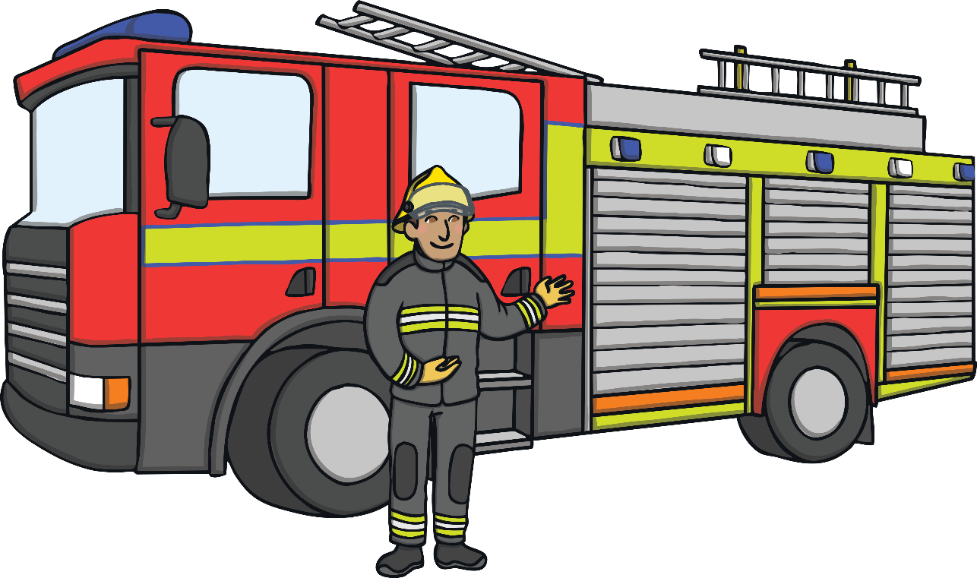
The fire station is where the fire engines live.

Slide 9
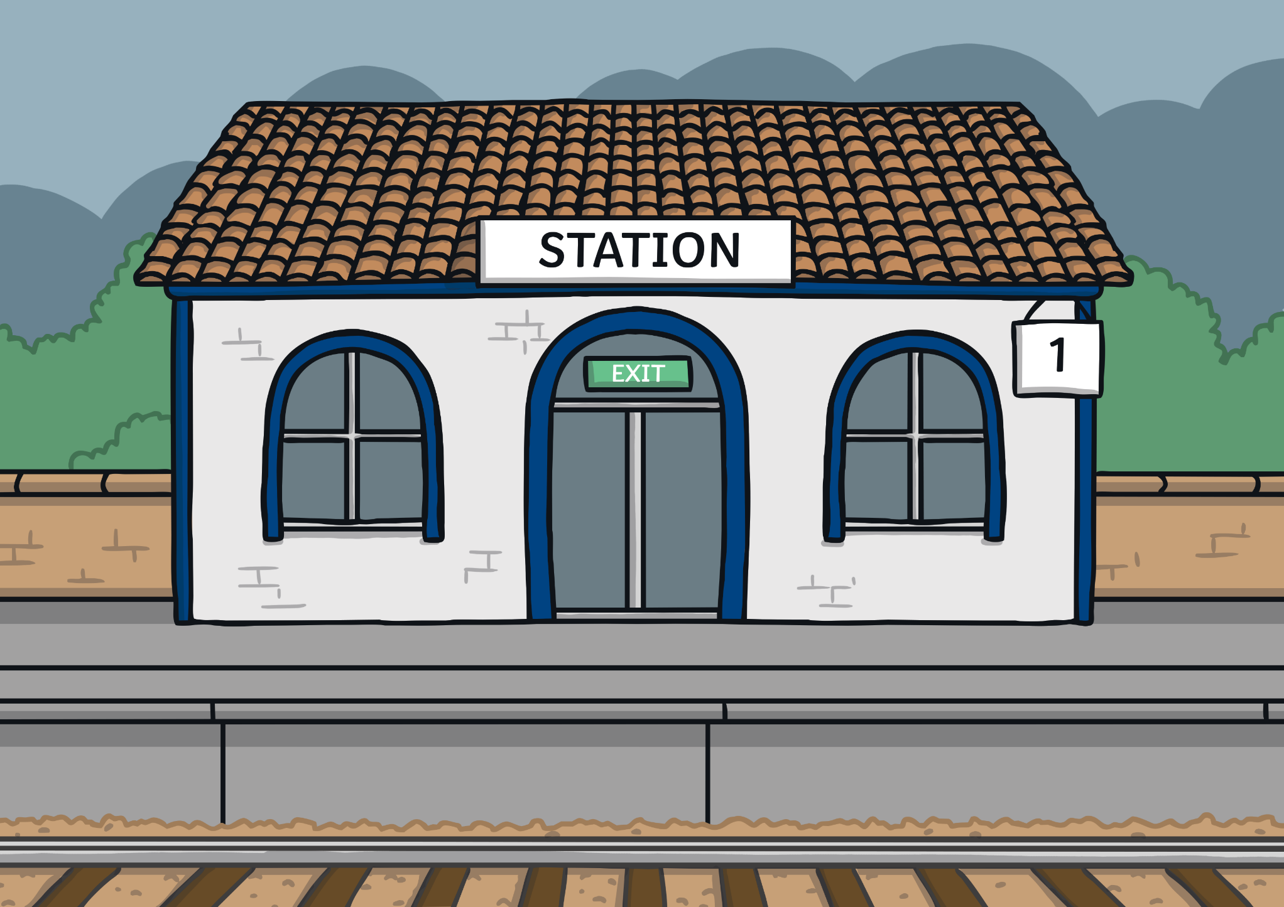
We catch trains at the train station.

Slide 10




After college, we can study at a university.

Slide 11
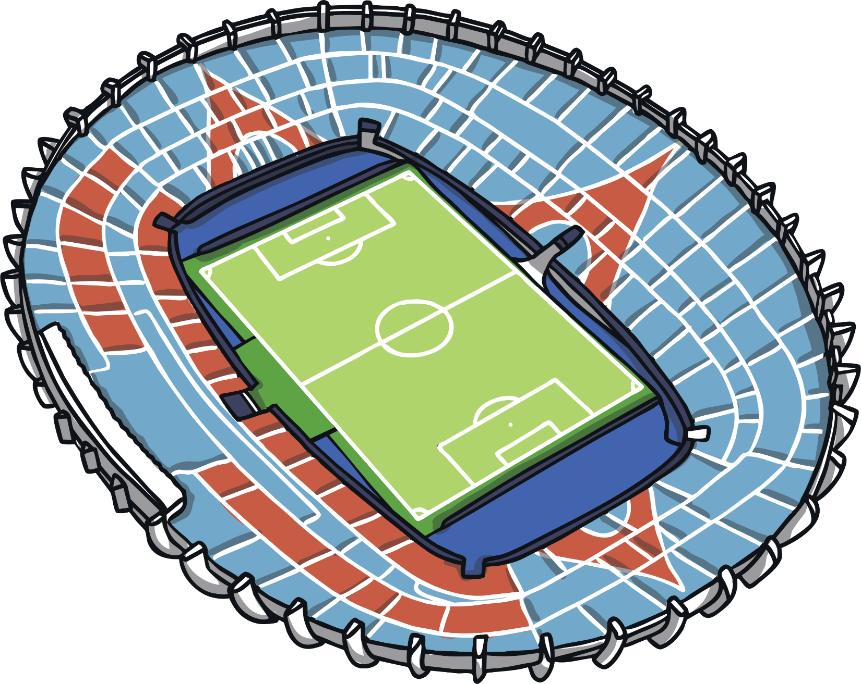
We watch sport at the stadium.

Slide 12
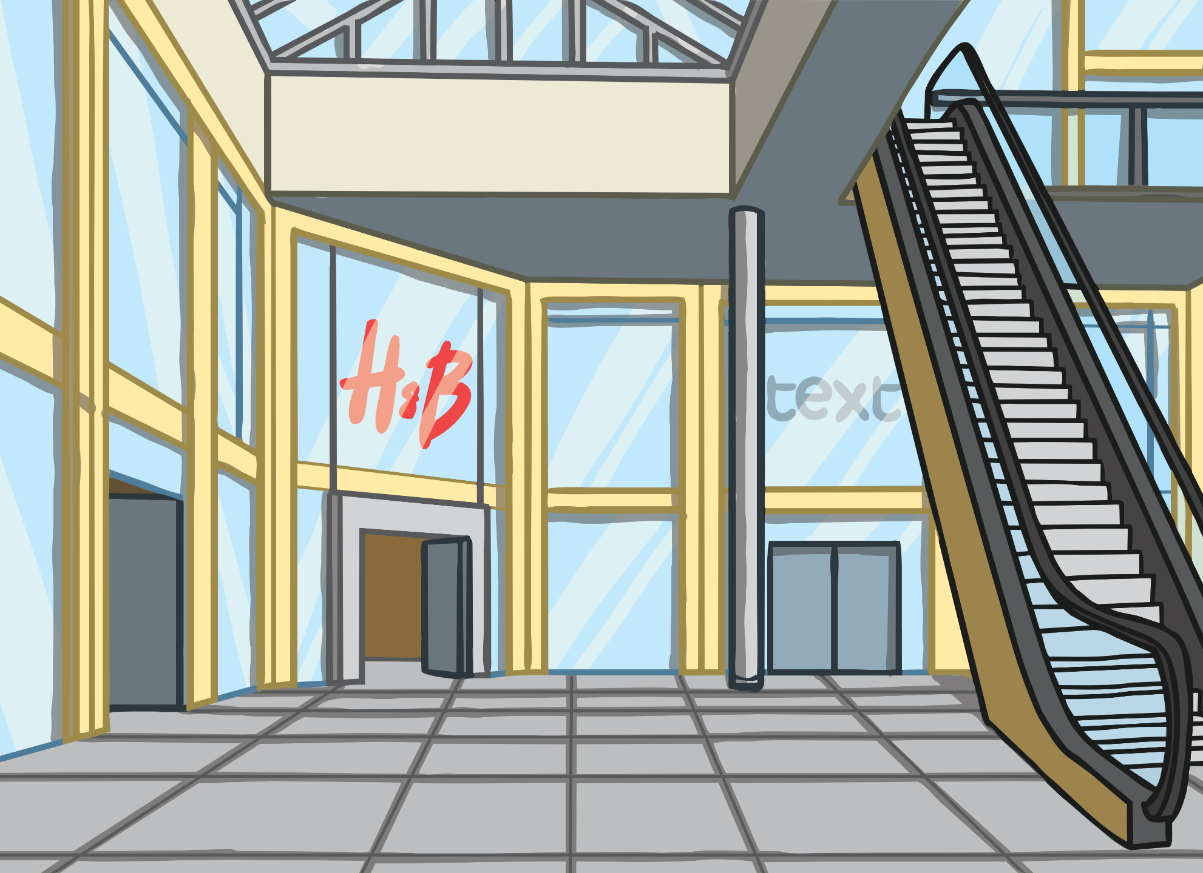
We go shopping at the shopping centre.

Slide 13
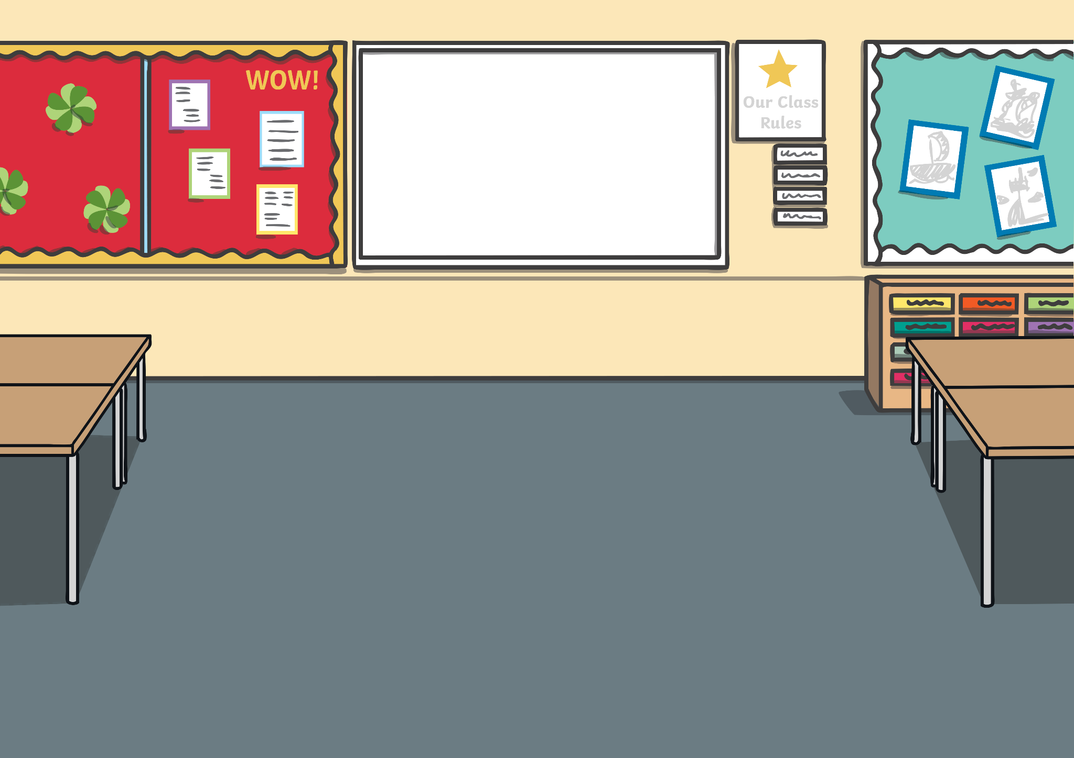
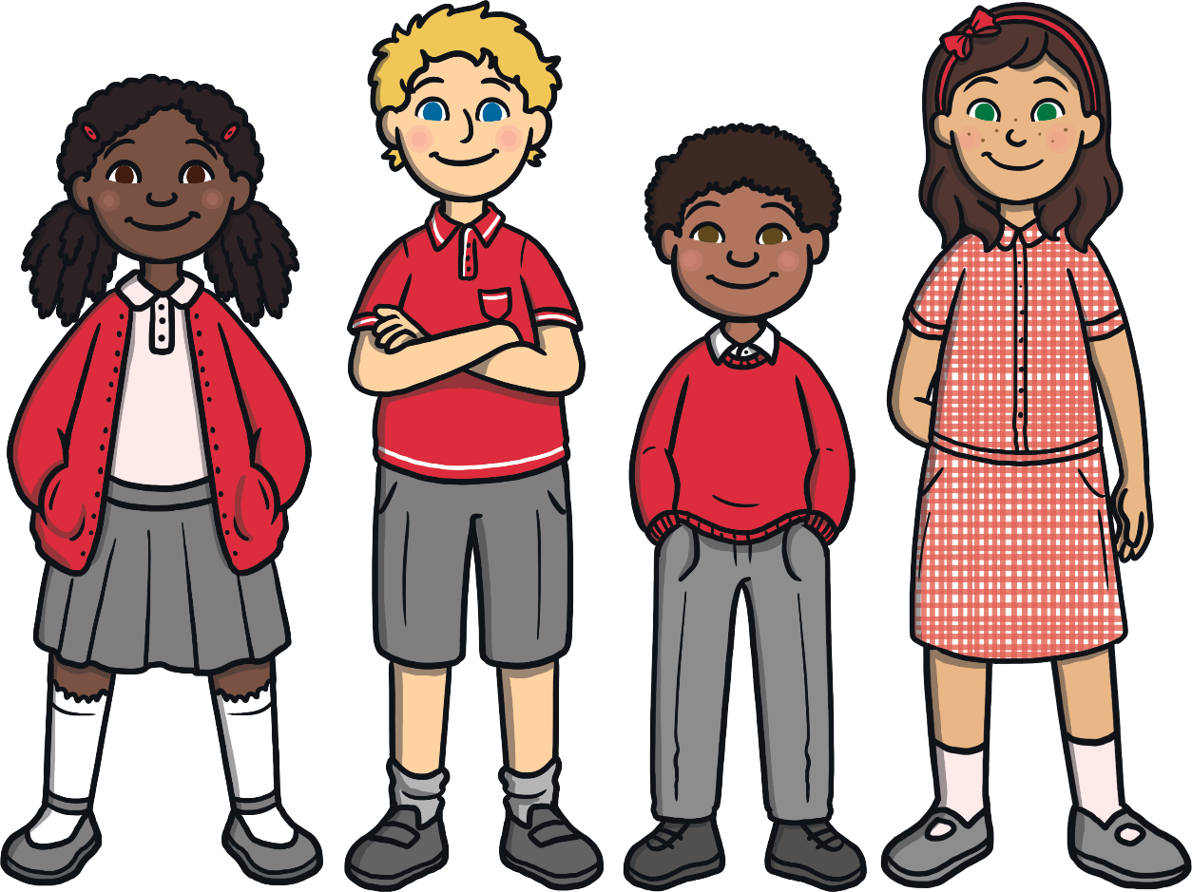
We can go to high school when we are 11 years old.

Slide 14
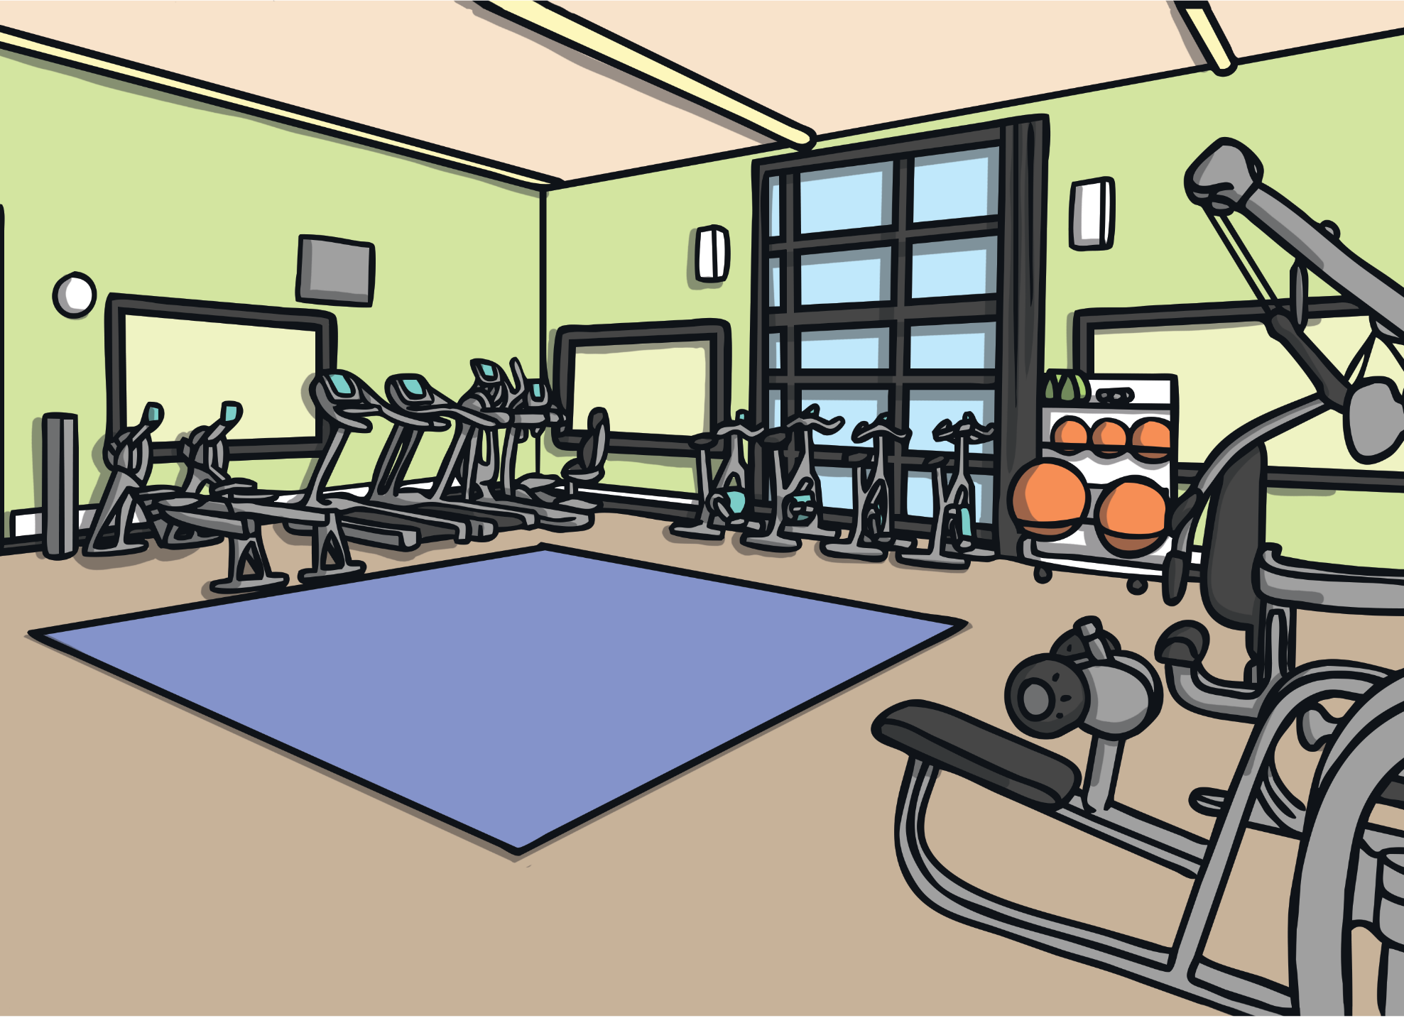
We exercise at the gym.

Slide 15
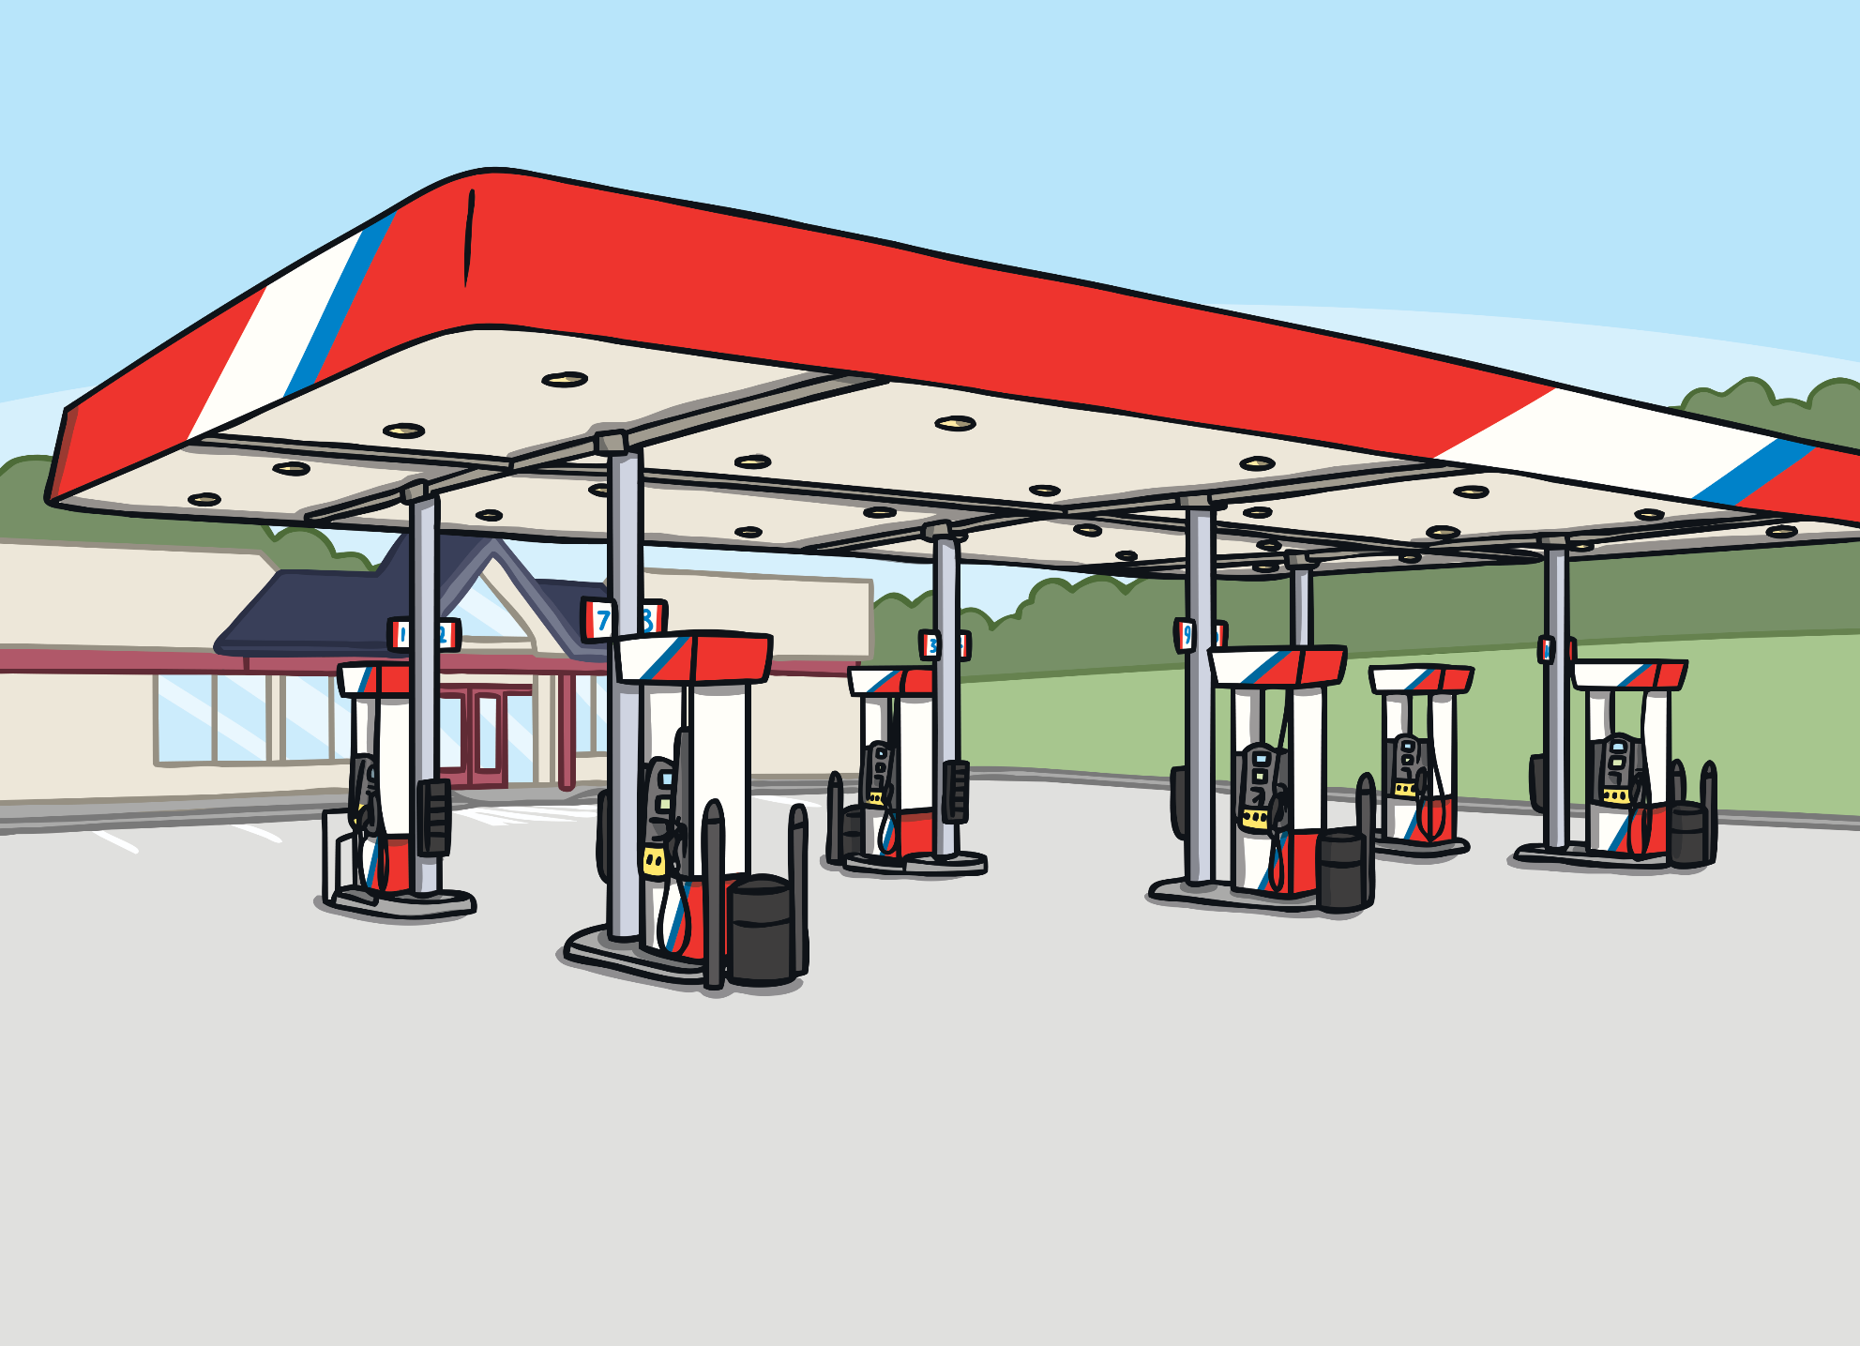
We get petrol at the petrol station.

Slide 16
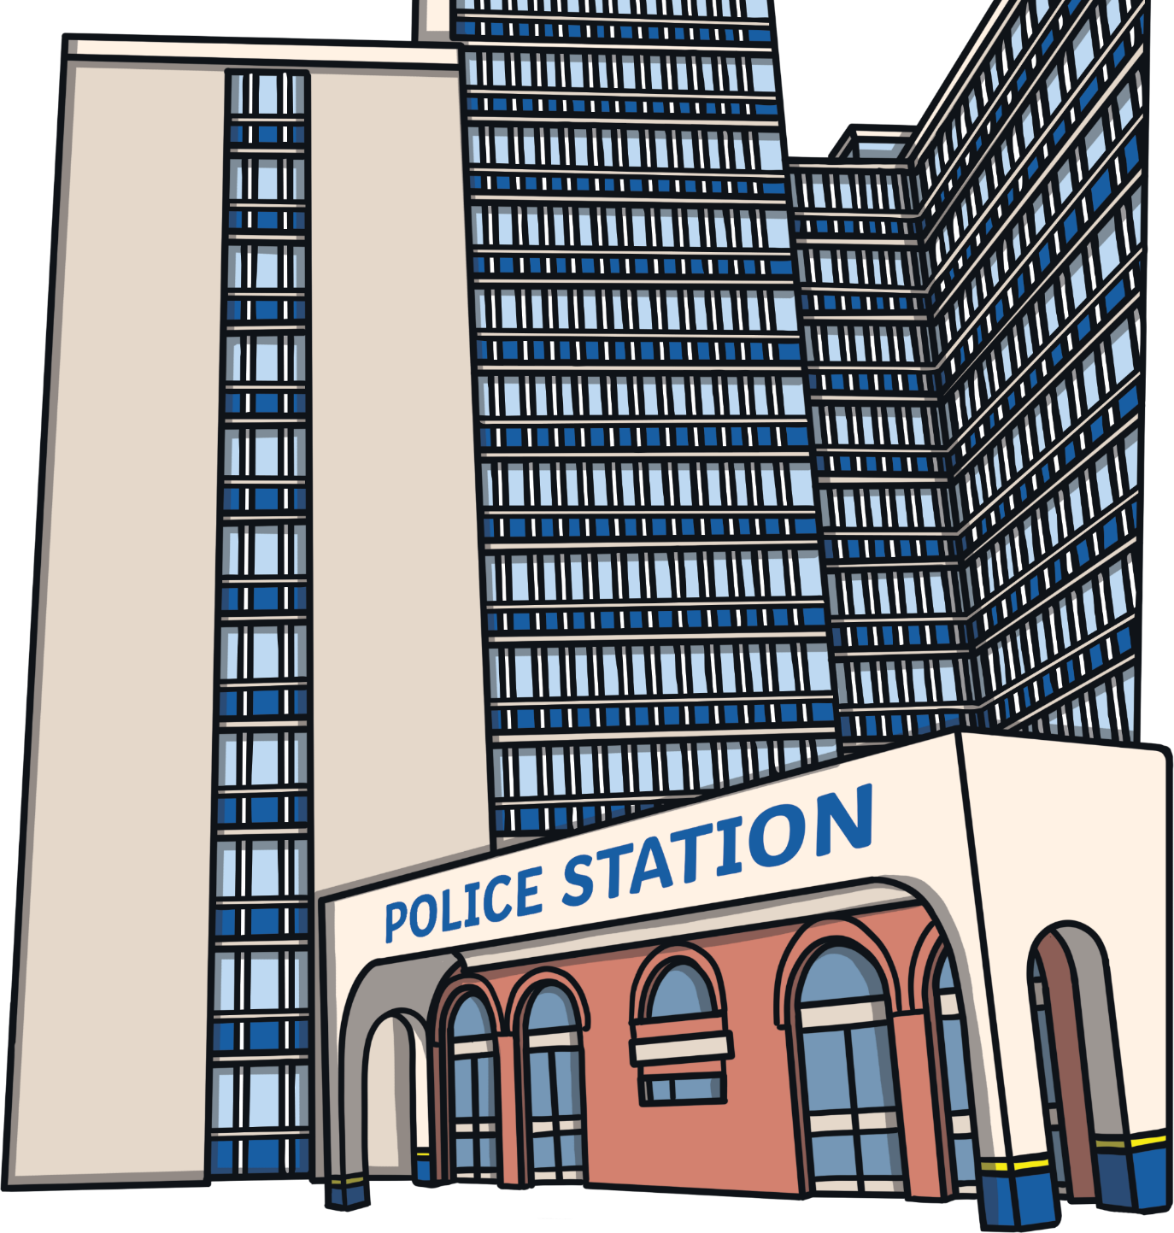
We report crimes at the police station.

Slide 17
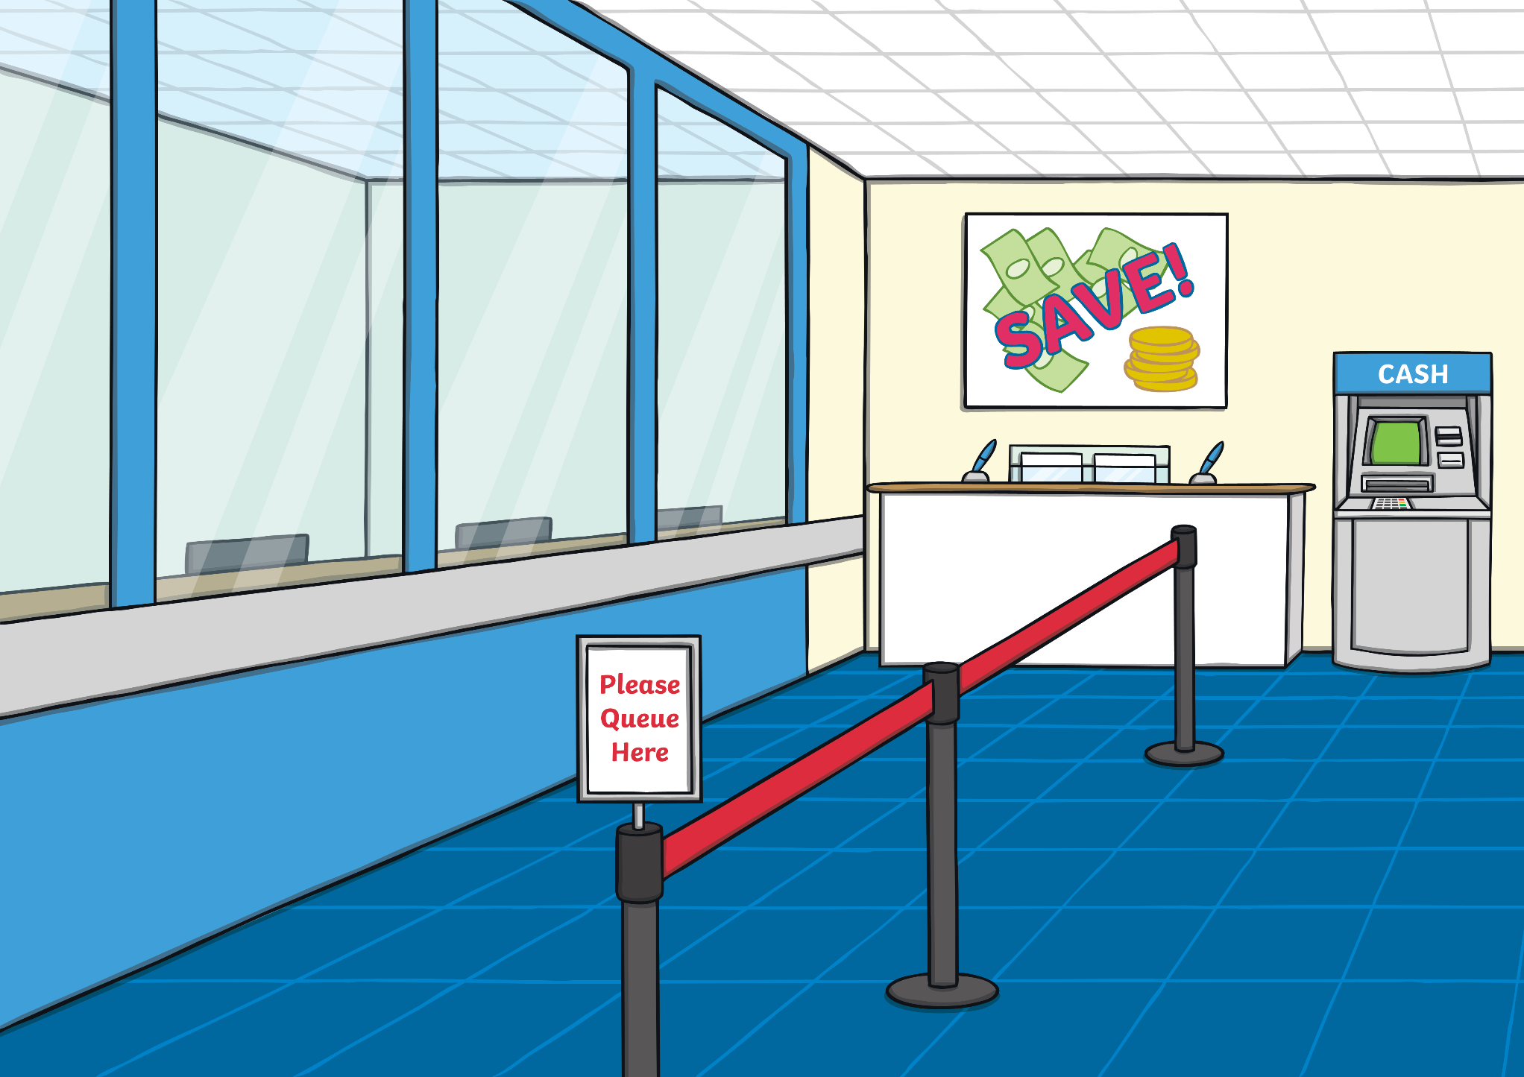
We can withdraw and deposit money at the bank.

Slide 18
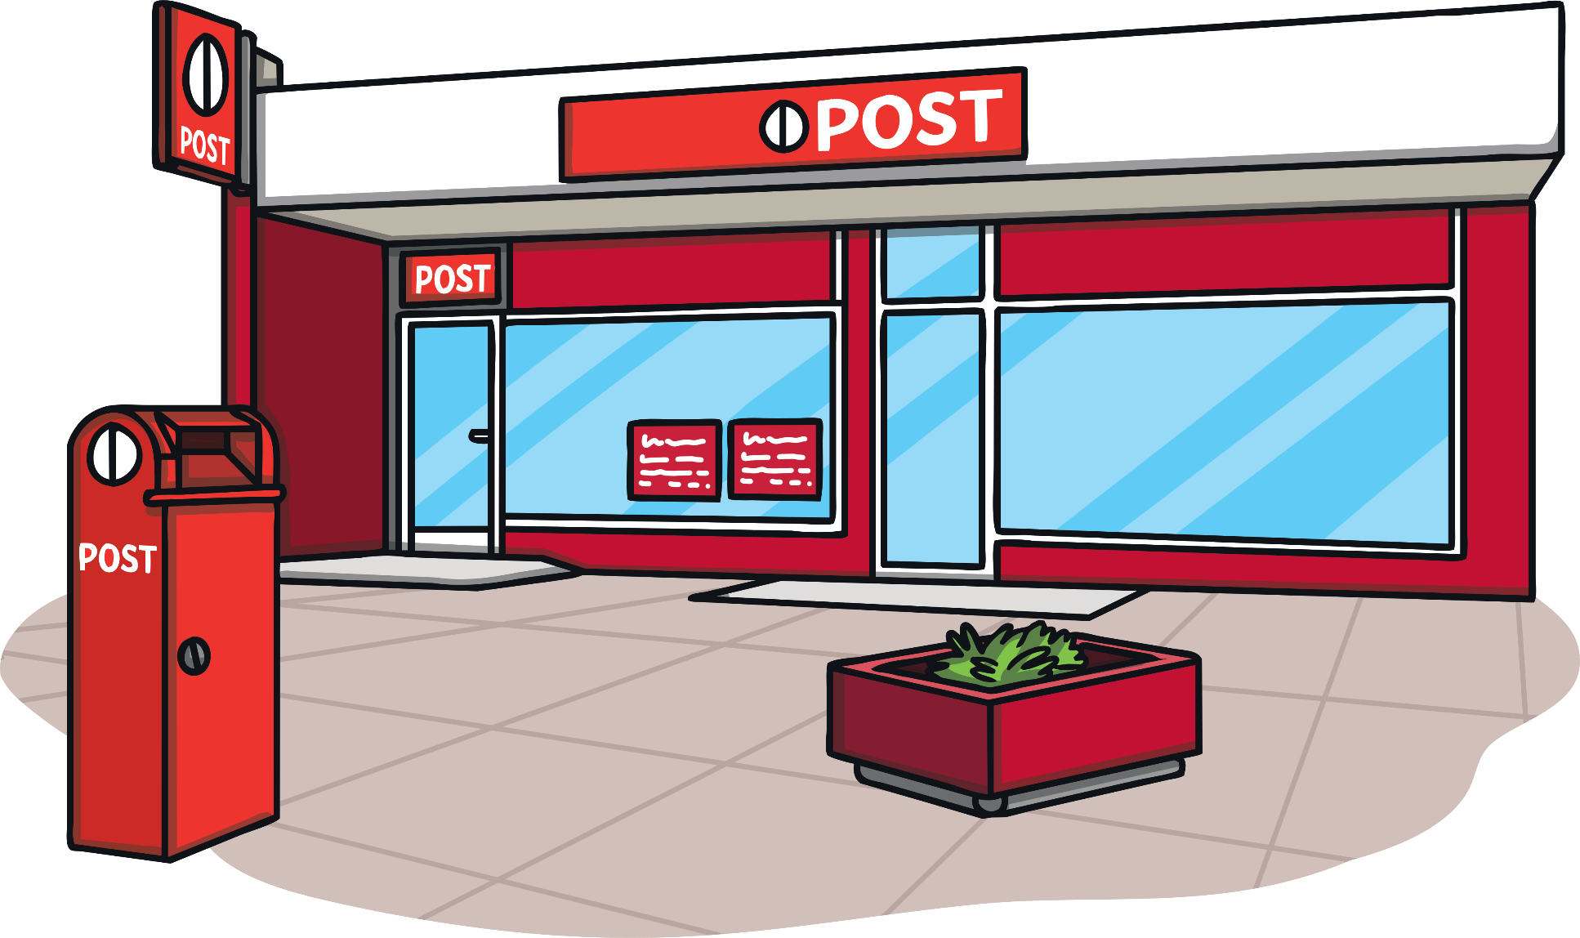
We can post letters at the Post Office.

Slide 19
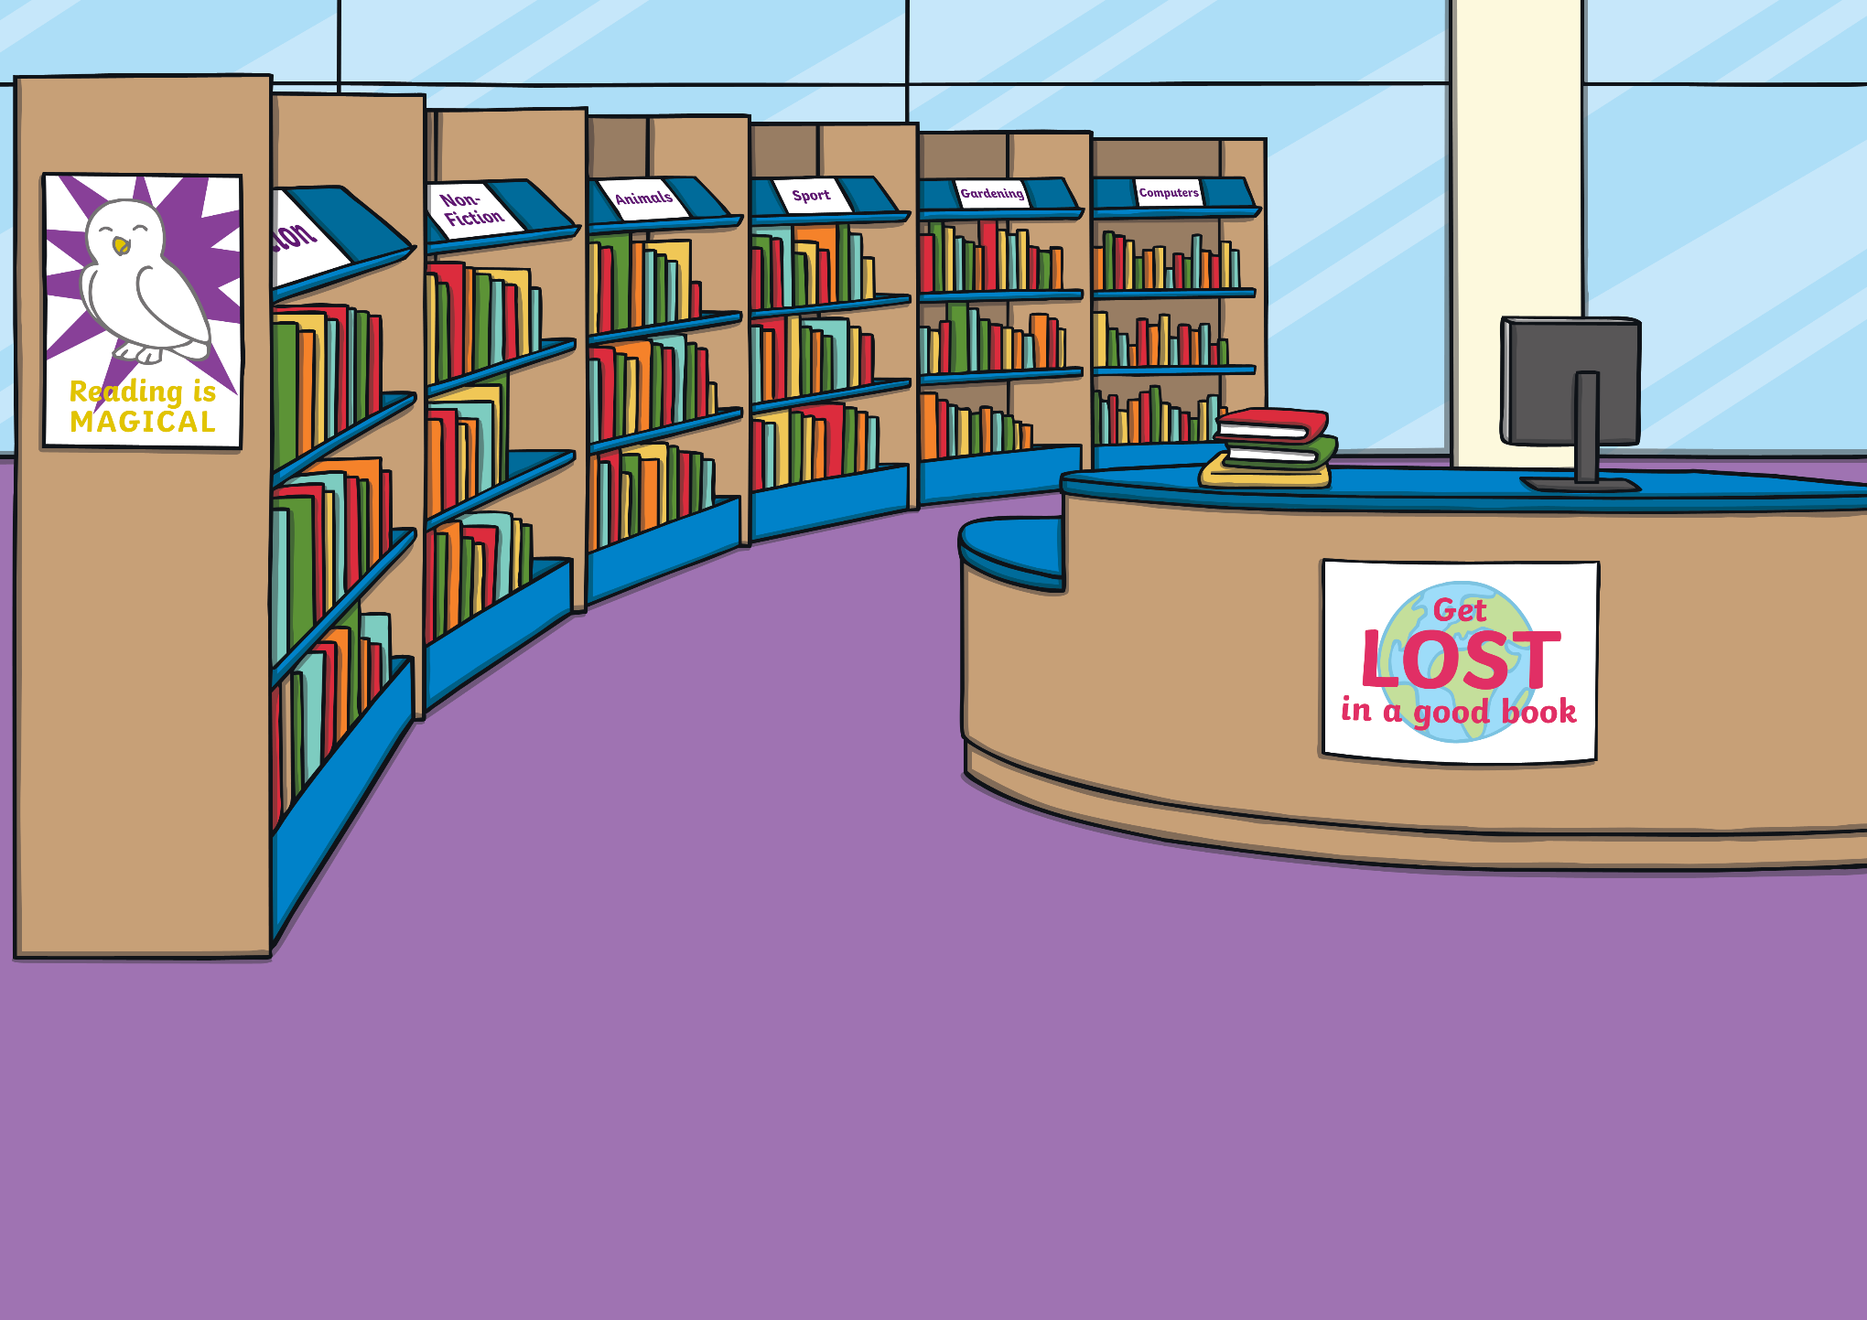
We borrow books from the community library.

Slide 20
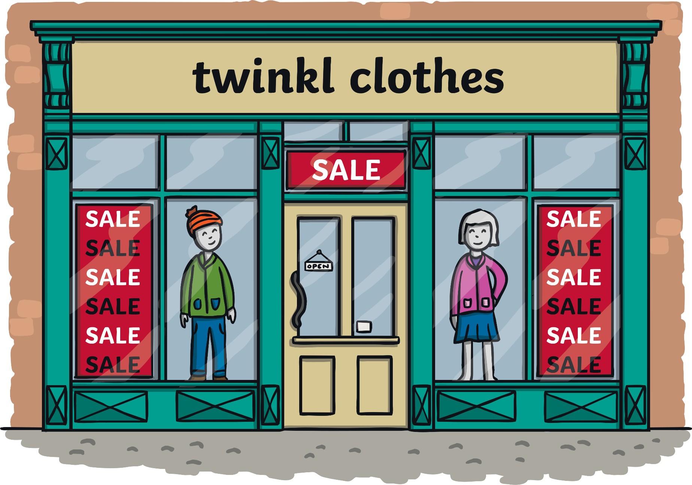
We buy new clothes at the clothing store.

Slide 21
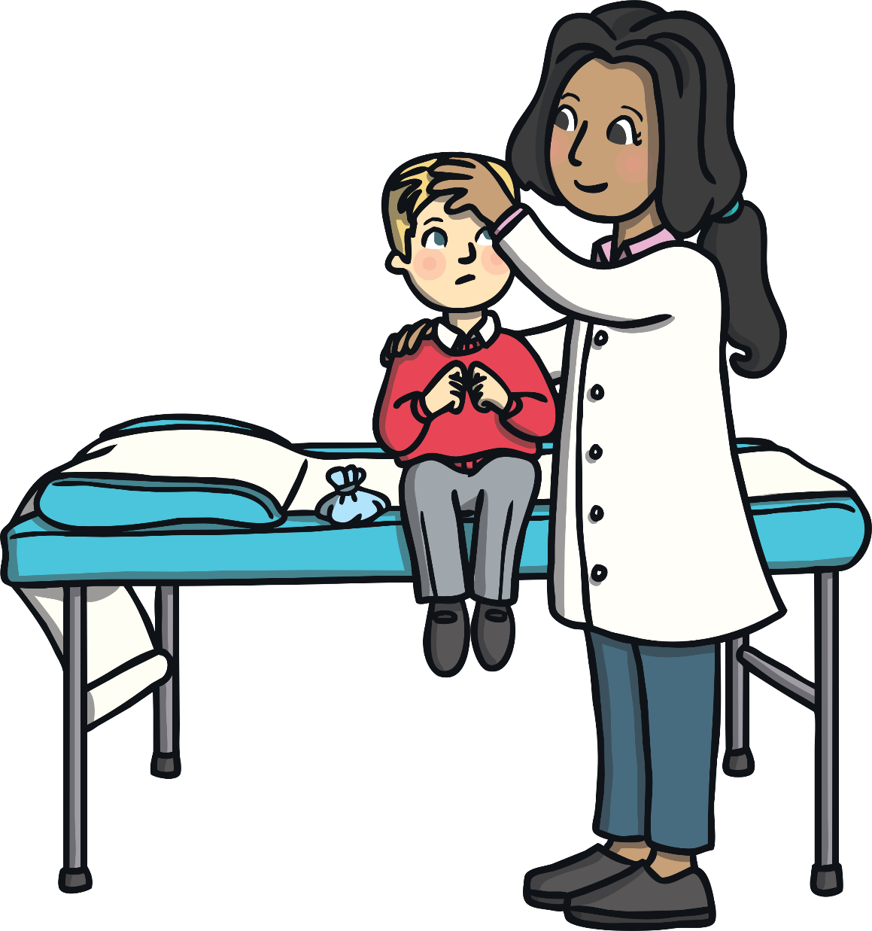
We visit the doctor when we are unwell.

Slide 22
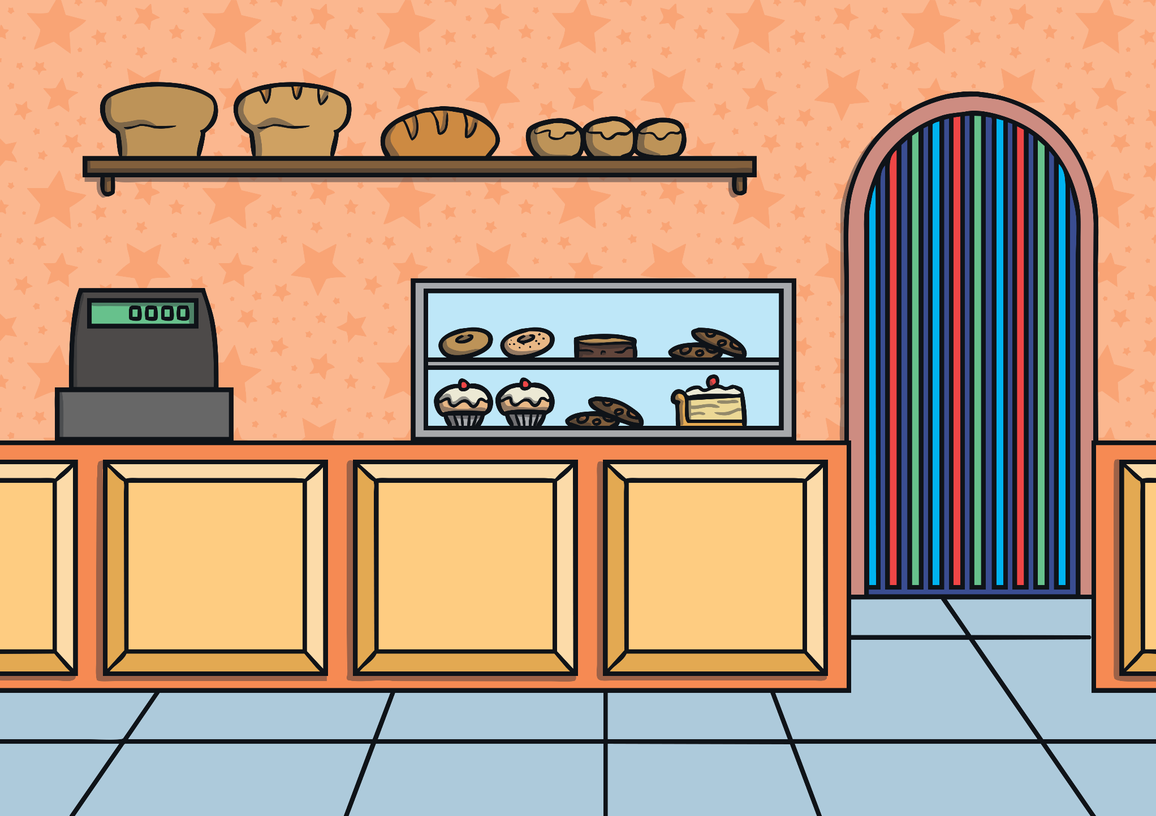
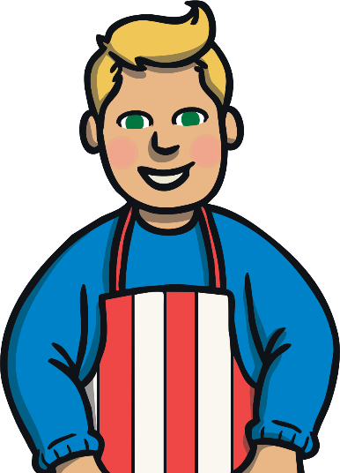
We buy fresh bread at the bakery.

Slide 23
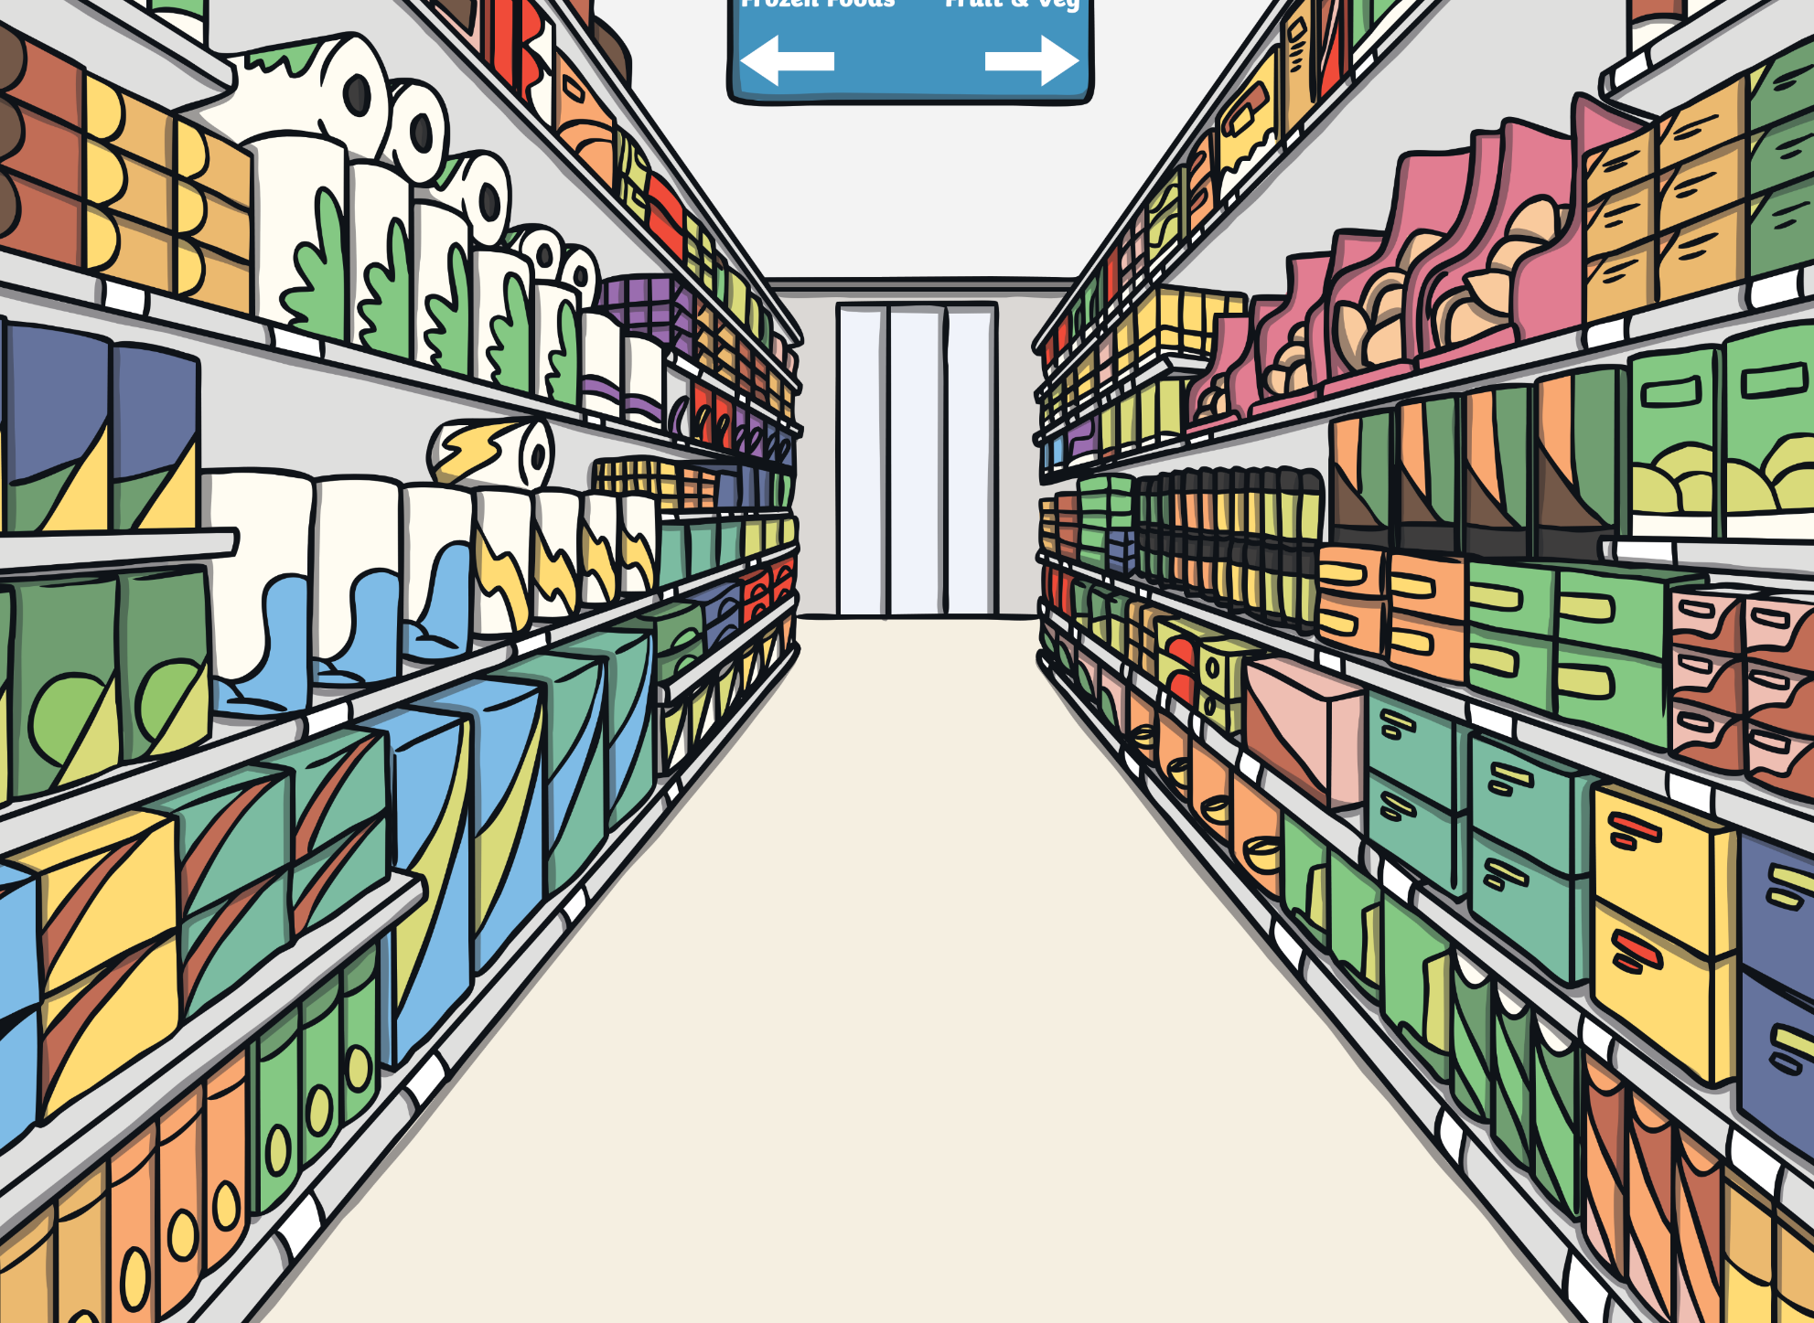
We buy groceries at the supermarket.

